Slide 1
广播

Slide 2
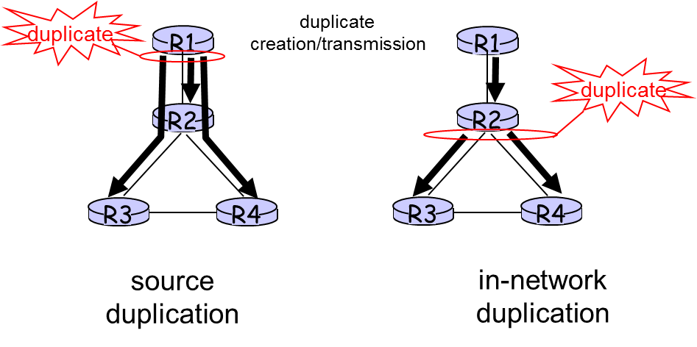
Broadcast Routing
deliver packets from source to all other nodes
source duplication is inefficient:
source duplication: how does source determine recipient addresses?

Slide 3
In-network duplication
flooding: when node receives brdcst pckt, sends copy to all neighbors
Problems: cycles & broadcast storm
controlled flooding: node only brdcsts pkt if it hasn’t brdcst same packet before
Node keeps track of pckt ids already brdcsted
Or reverse path forwarding (RPF): only forward pckt if it arrived on shortest path between node and source
spanning tree
No redundant packets received by any node

Slide 4
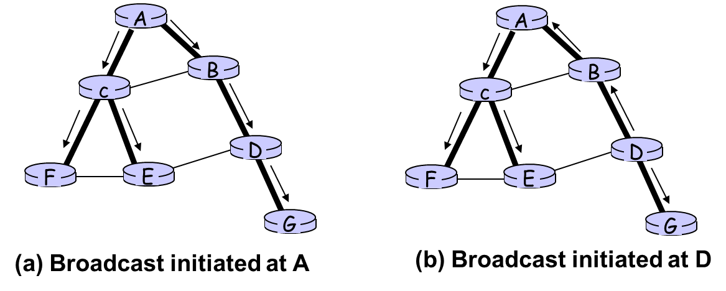
Spanning Tree
First construct a spanning tree
Nodes forward copies only along spanning tree

Slide 5
Spanning Tree: Creation
Center node
Each node sends unicast join message to center node
Message forwarded until it arrives at a node already belonging to spanning tree
Stepwise construction of spanning tree
(b) Constructed spanning tree
A
A
3
B
B
c
c
4
2
D
D
F
E
F
E
1
5
G
G

Slide 6

Summary
Broadcast Routing
Spanning Tree

